Slide 1

C Programming Language
Introduction
www.btechsmartclass.com

Slide 2
What is C Language?
C is a general-purpose computer programming language.
C is also said to be structures programming language or function oriented programming language.
C is a High level programming language.
1

Slide 3
Why do we use C?
C language is used to create applications or software.
Initially, C was developed to create an operating system called UNIX.
The popular software like Linux OS, PHP & MySQL are created using C language.
2

Slide 4

Why do we use C?
Generally C Language is used to create the following…
Operating Systems
Language Compilers
Assemblers
Interpreters
Text Editors
Network Drivers
Databases
3

Slide 5
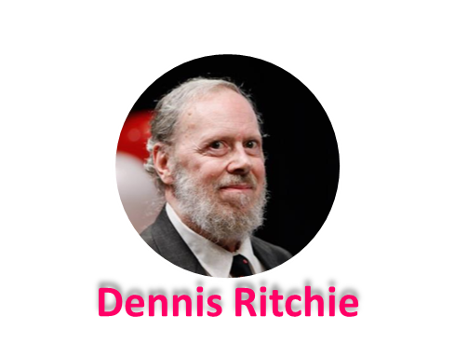
History of C Language?
C Language was developed by Dennis Ritchie in the year of 1972.
Born – September 9, 1941
Profession – Computer Scientist
Place – Bell Labs, US
Known As – Father of C & UNIX
Awards – Turing Award(1983)
National Medal of Technology(1998)
IEEE Medal(1990)
Computer Pioneer Award(1994)
Computer History Museum Fellow(1997)
Harold Pender Award(2003)
Died – October 12, 2011
4

Slide 6
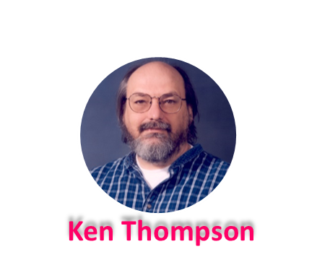
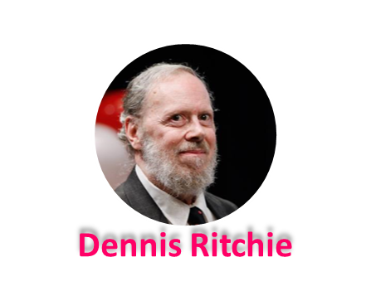
History of C Language?
Let’s see the programming languages that were developed before C language…
CPL – Common Programming Language invented by Martin Richards in 1960’s
BCPL – Basic Combined Programming Language by Martin Richards in 1966
B Language – by Ken Thompson & Dennis Ritchie in 1969
Traditional C – by Dennis Ritchie in 1972
K&R C – by Kernighan & Dennis Ritchie in 1978
ANSI C – by ANSI Committee in 1989
ANSI/ISO C – by ISO Committee in 1990
C99 – by Standardization Committee in 1999
4

Slide 7


For more information please visit www.btechsmartclass.com
Please do subscribe my channel

